Slide 1
Introduction to Image Processing and Computer Vision
Fundamentals, Tools, and Applications
Computer Vision, 6th Semester, 2024

Slide 2
Basics of Visual Media
Images and Videos

Slide 3
Images
2D representation of a 3D scene
2D signal representing visual perception
Function of x-y coordinates as f(x, y) representing the intensity of light perceived from each coordinate:
f(x, y) = I(x, y) * R(x, y)
I(x, y) = intensity of incident light on pixel space (x, y)
R(x, y) = reflectivity of pixel space (x, y)

Slide 4
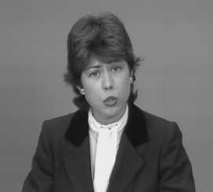
A Digital Image
Digital image representation
origin
x
f (x, y)
(Gray level)
y

Slide 5
Types of Images
Based on colours:
Binary (Black and White)
Grayscale (N Shades of Gray)
Color (RGB, CMYK, HSV, HSI, False-Color, Hyperspectral, etc.)
Based on image rendering:
Raster Image (pixel formation)
Vector Image (mathematical shape rendering)
Formats:
Tagged Image File Format (TIFF)
Bit Map (BMP)
Joint Photographic Experts Group (JPG/JPEG)
Portable Network Graphics (PNG)
Graphics Interchange Format (GIF)
Photoshop Document (PSD)
Portable Document Format (PDF)
Encapsulated PostScript (EPS)
Adobe Illustrator Document (AI)
Scalable Vector Graphics (SVG)
RAW files
Web Picture Format (WEBP)
Microsoft Icon (ICO)

Slide 6
Videos
Sequence of individual frames/images with semantic relation/link over time
3D signal comprising collection of images linked over time
Sense of motion of objects in image
Function f(x, y, t) where t is the time dimension
Frame rate: No. of frames accessed / transmitted / “played” per second

Slide 7
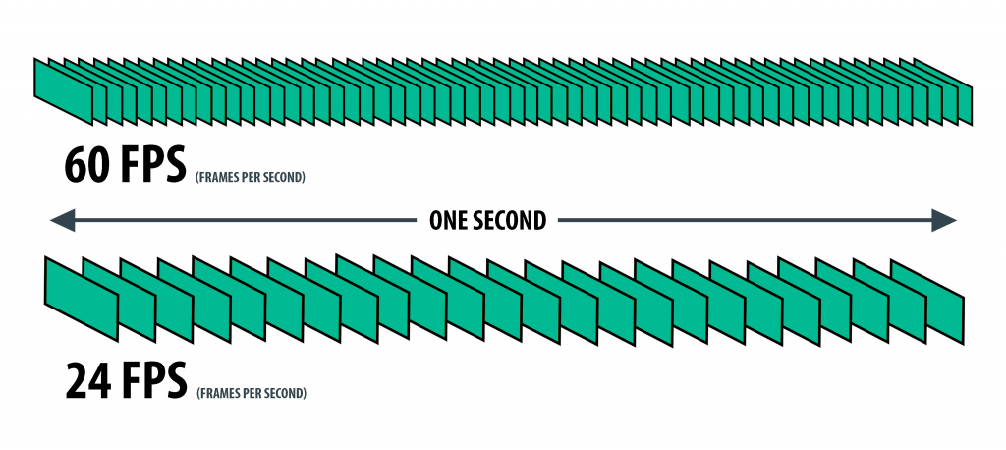
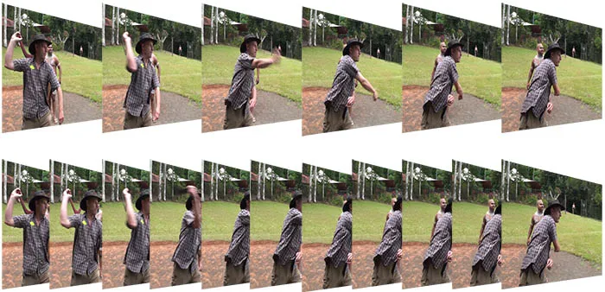
Frame Rate Difference in Videos

Slide 8
Domains of Visual Media Analysis and Computing
Image and Video Processing
Computer Vision
Computer Graphics
Pattern Recognition (by Artificial Intelligence)

Slide 9
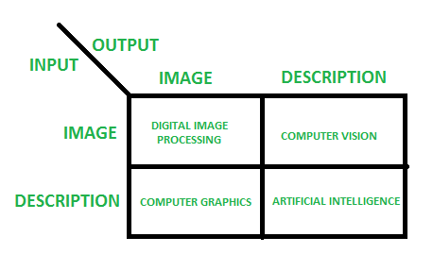
Difference of domains

Slide 10
Image Processing

Slide 11
Concepts
Digital Image Processing:
use of a digital computer to process digital images through an algorithm
class of methods that deal with manipulating digital images through the use of computer algorithms
process of transformation of a digital image into required formats for manipulation and understanding

Slide 12
Tools/methods
Image Enhancement and Restoration:
Histogram Equalization
Contrast stretching
Image Correction
Image Transformation:
Fourier Transform
Cosine Transform
Hough Transform
Image Filtering:
Spatial filtering (max, min, mean, median, etc.)
Frequency-domain filtering (cepstrum-based)
Segmentation:
Thresholding
Region growing and merging
Clustering
Image Compression
Color Image Manipulation
Video Enhancement and Filtering

Slide 13
Applications
Noise Filtering
Contrast Enhancement
Image Deblurring
Image Correction
Image Inpainting
Image Fusion
Image Stitching
Transformations
Astronomy
Weather Forecasting
Medical Imaging
Artistic Effects
Document Image Analysis
Hyperspectral Imaging

Slide 14
Applications
Noise Filtering
Contrast Enhancement
Image Deblurring
Image Correction
Image Inpainting
Image Fusion
Image Stitching
Transformations
Astronomy
Weather Forecasting
Medical Imaging
Artistic Effects
Document Image Analysis
Hyperspectral Imaging

Slide 15
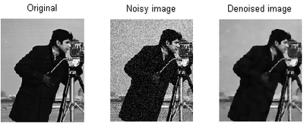
Noise Removal

Slide 16
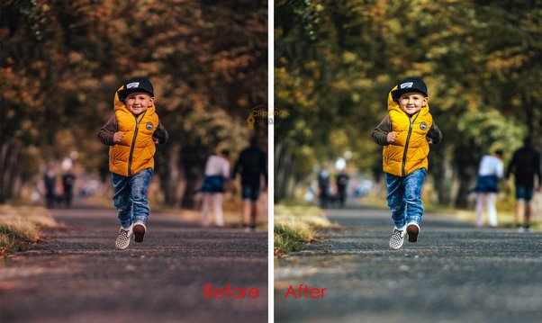
Image Correction

Slide 17
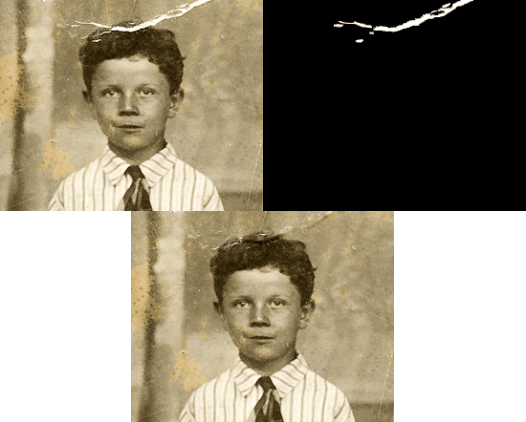
Image Inpainting

Slide 18
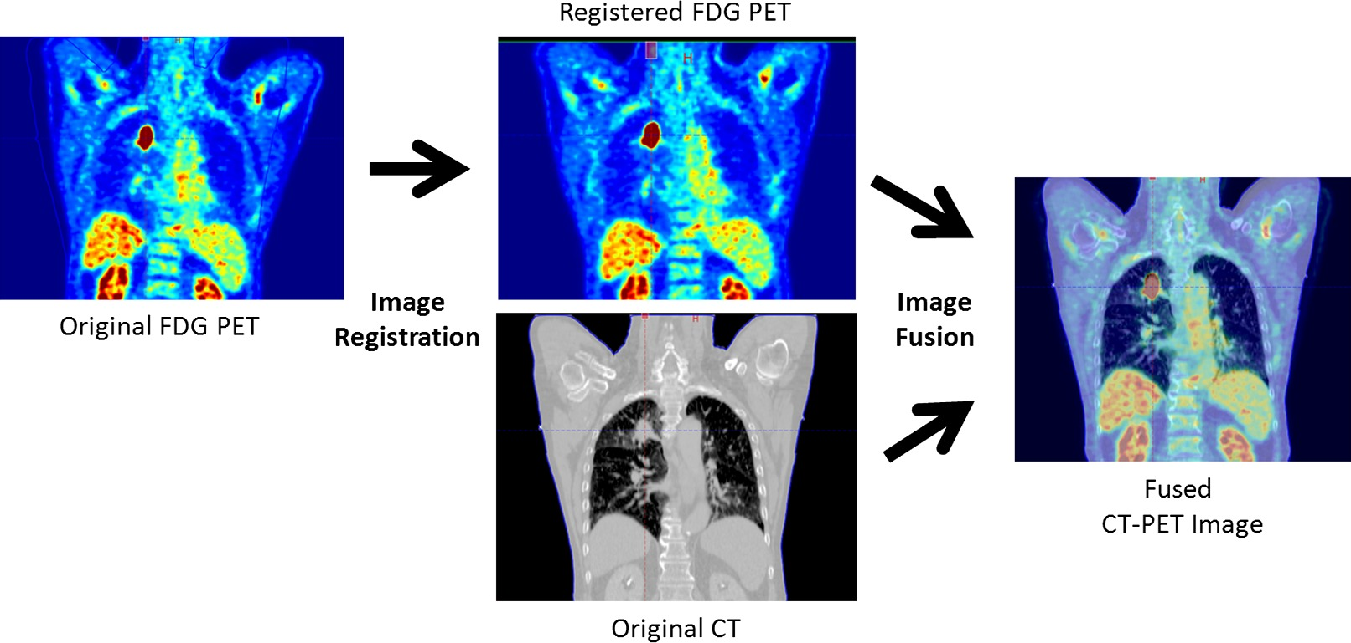
Image Fusion

Slide 19
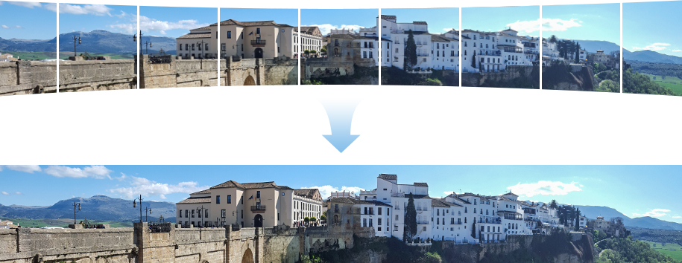
Image Stitching

Slide 20
Computer Vision

Slide 21
Concepts
Field of study within artificial intelligence (AI) that focuses on enabling computers to intercept and extract information from images and videos, in a manner similar to human vision
Developing algorithms and techniques to extract meaningful information from visual inputs and make sense of the visual world.
Involves image processing along with artificial intelligence

Slide 22
Techniques
Image Classification
Object Detection and Tracking
Semantic and Instance Segmentation
Depth Perception
Image Captioning
Image Generation
Style Transfer
Object Reconstruction
Feature Matching
Image Registration and Fusion
Video Motion Analysis

Slide 23
Applications
Medical Image Analysis in Healthcare
Transportation and Traffic Control
Monitoring in Manufacturing
Monitoring and Assistance in Agriculture
Security surveillance
Military surveillance
Forensic Analysis, etc.

Slide 24
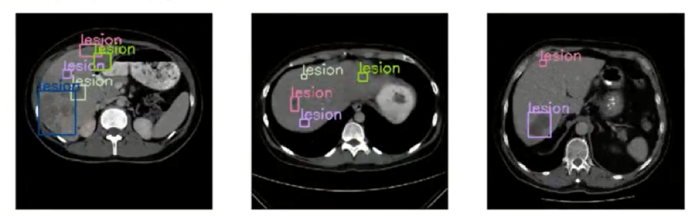
Medical Image Analysis

Slide 25
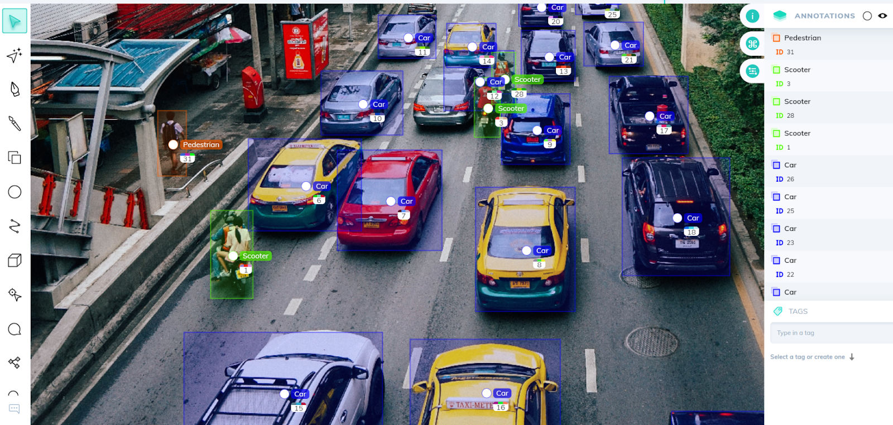
Transportation and Traffic

Slide 26
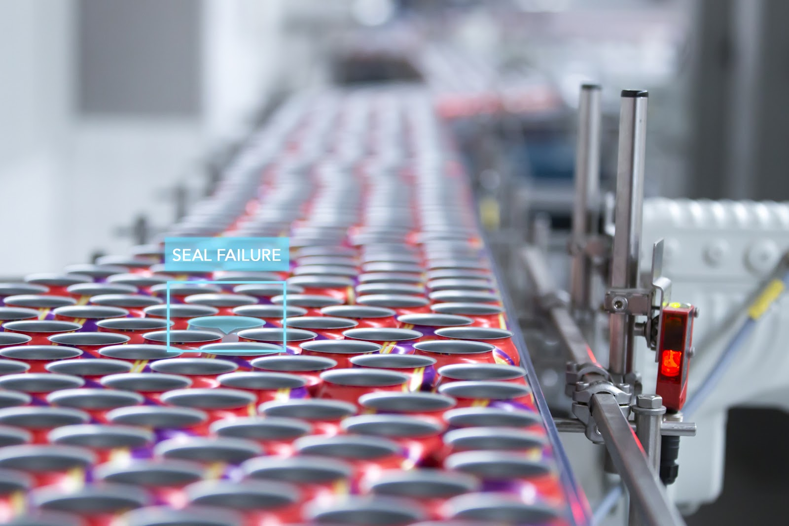
Manufacturing

Slide 27
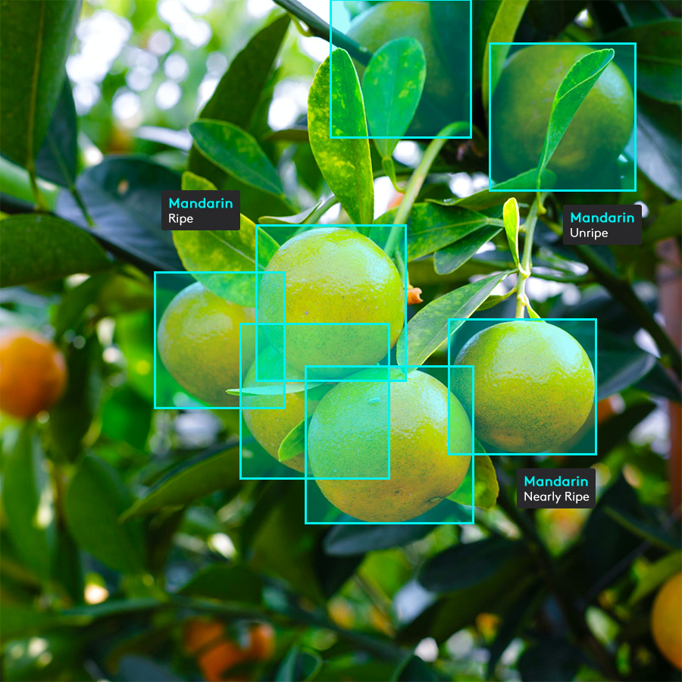
Agriculture

Slide 28
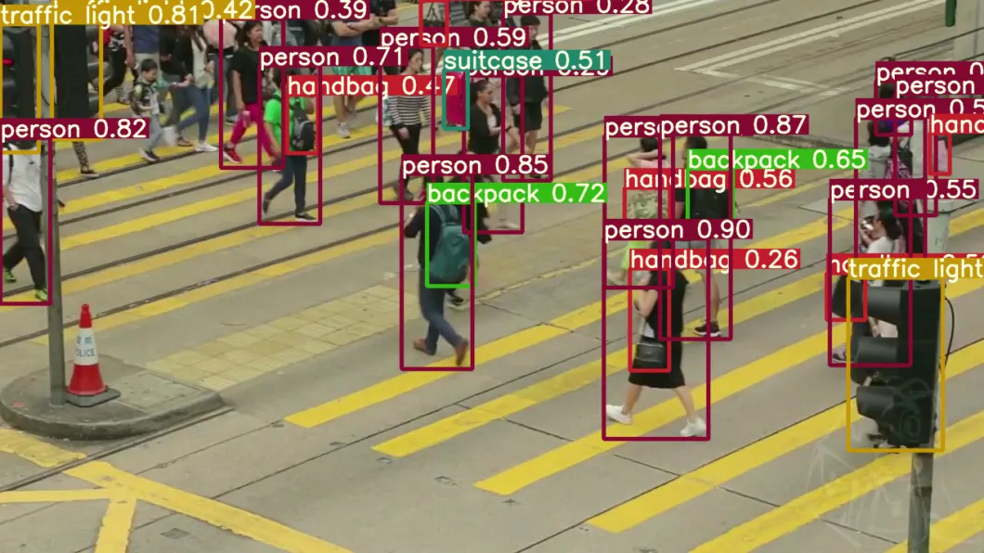
Security Surveillance

Slide 29
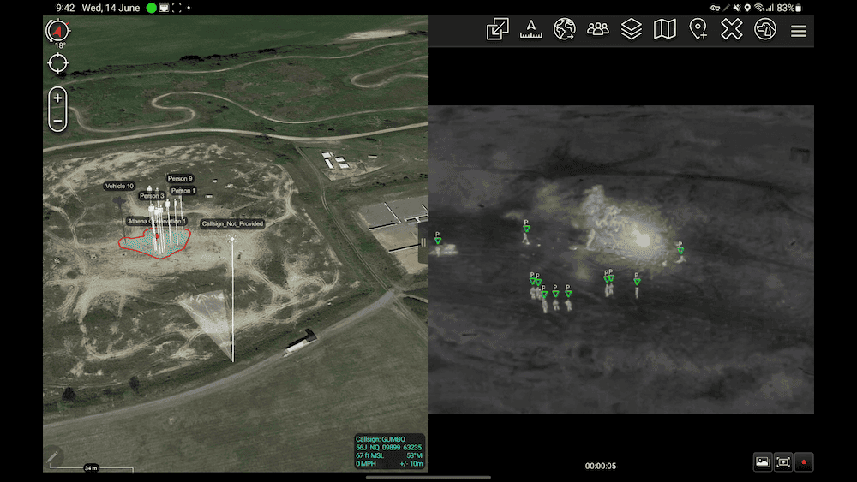
Military Surveillance

